Slide 1
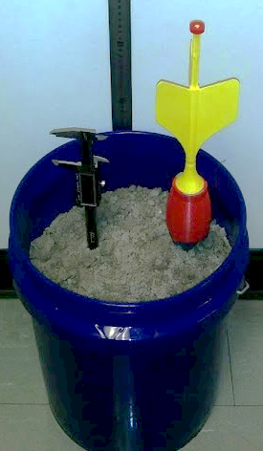
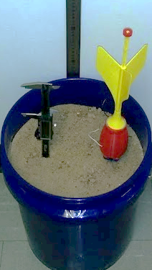
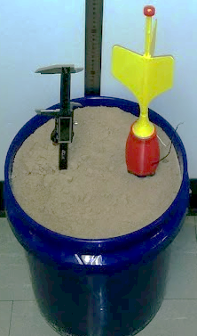
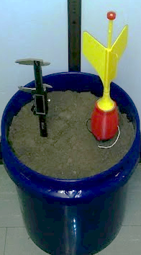
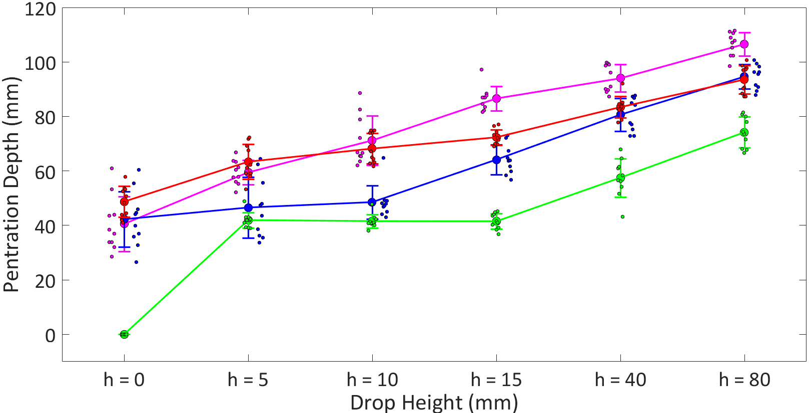

Penetrometer Readings (kg/${cm}^{2}$):
0.056 0.089 0.099 0.135
Soil Type: River Sand Coarse Sand Masons Sand Top Soil

